Slide 1
AZ-700T00A Module 08: Design and Implement Network Monitoring
Notes:
Secure and Monitor Networks (15–20%)
Monitor networks
• configure network health alerts and logging by using Azure Monitor
• create and configure a Connection Monitor instance
• configure and use Traffic Analytics
• configure NSG flow logs
• enable and configure diagnostic logging
• configure Azure Network Watcher

Slide 2
Module Overview
Lesson 01: Monitor your networks using Azure Monitor
Lesson 02: Exercise – Monitor a load balancer resource using Azure Monitor
Lesson 03: Use Azure Network Watcher to troubleshoot and analyze your network
Notes:
Module overview
Secure and Monitor Networks (15–20%)
Monitor networks
• configure network health alerts and logging by using Azure Monitor
• create and configure a Connection Monitor instance
• configure and use Traffic Analytics
• configure NSG flow logs
• enable and configure diagnostic logging
• configure Azure Network Watcher

Slide 3
Lesson 01: Monitor your networks using Azure Monitor

Slide 4
Monitor your networks using Azure Monitor Overview
What is Azure Monitor?
Metrics explorer
Azure Monitor Network Insights
Review

Slide 5
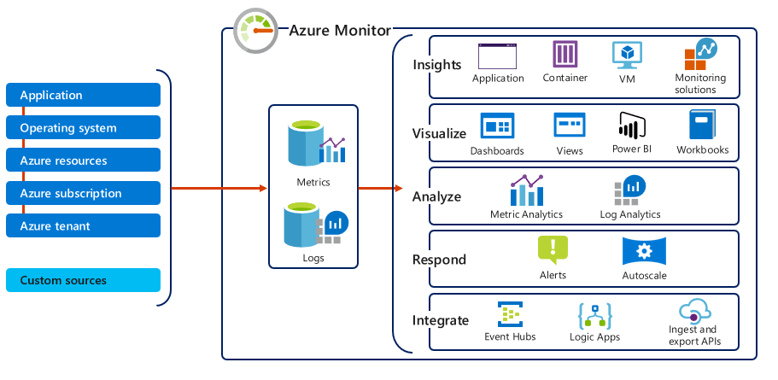
Azure Monitor
Monitoring data types: Metrics & Logs
Metrics are numerical values that describe some aspect of a system at a point in time
They are lightweight and capable of supporting near real-time scenarios
Logs contain different kinds of data organized into records with different sets of properties for each type
Telemetry (events, traces) and performance data can be combined for analysis
Notes:
Azure Monitor for Networks provides a comprehensive view of health and metrics for all deployed network resources, without requiring any configuration. It also provides access to network monitoring capabilities like Connection Monitor, flow logging for network security groups, and Traffic Analytics. For more information, see Azure Monitor Network Insights.
Azure Monitor helps you maximize the availability and performance of your applications and services. It delivers a comprehensive solution for collecting, analyzing, and acting on telemetry from your cloud and on-premises environments. This information helps you understand how your applications are performing and proactively identify issues affecting them and the resources they depend on.
Just a few examples of what you can do with Azure Monitor include:
Detect and diagnose issues across applications and dependencies with Application Insights.
Correlate infrastructure issues with VM insights and Container insights.
Drill into your monitoring data with Log Analytics for troubleshooting and deep diagnostics.
Support operations at scale with smart alerts and automated actions.
Create visualizations with Azure dashboards and workbooks.
Collect data from monitored resources using Azure Monitor Metrics.
The diagram below offers a high-level view of Azure Monitor. At the center of the diagram are the data stores for metrics and logs, which are the two fundamental types of data used by Azure Monitor. On the left are the sources of monitoring data that populate these data stores. On the right are the different functions that Azure Monitor performs with this collected data. This includes such actions as analysis, alerting, and streaming to external systems.

Slide 6
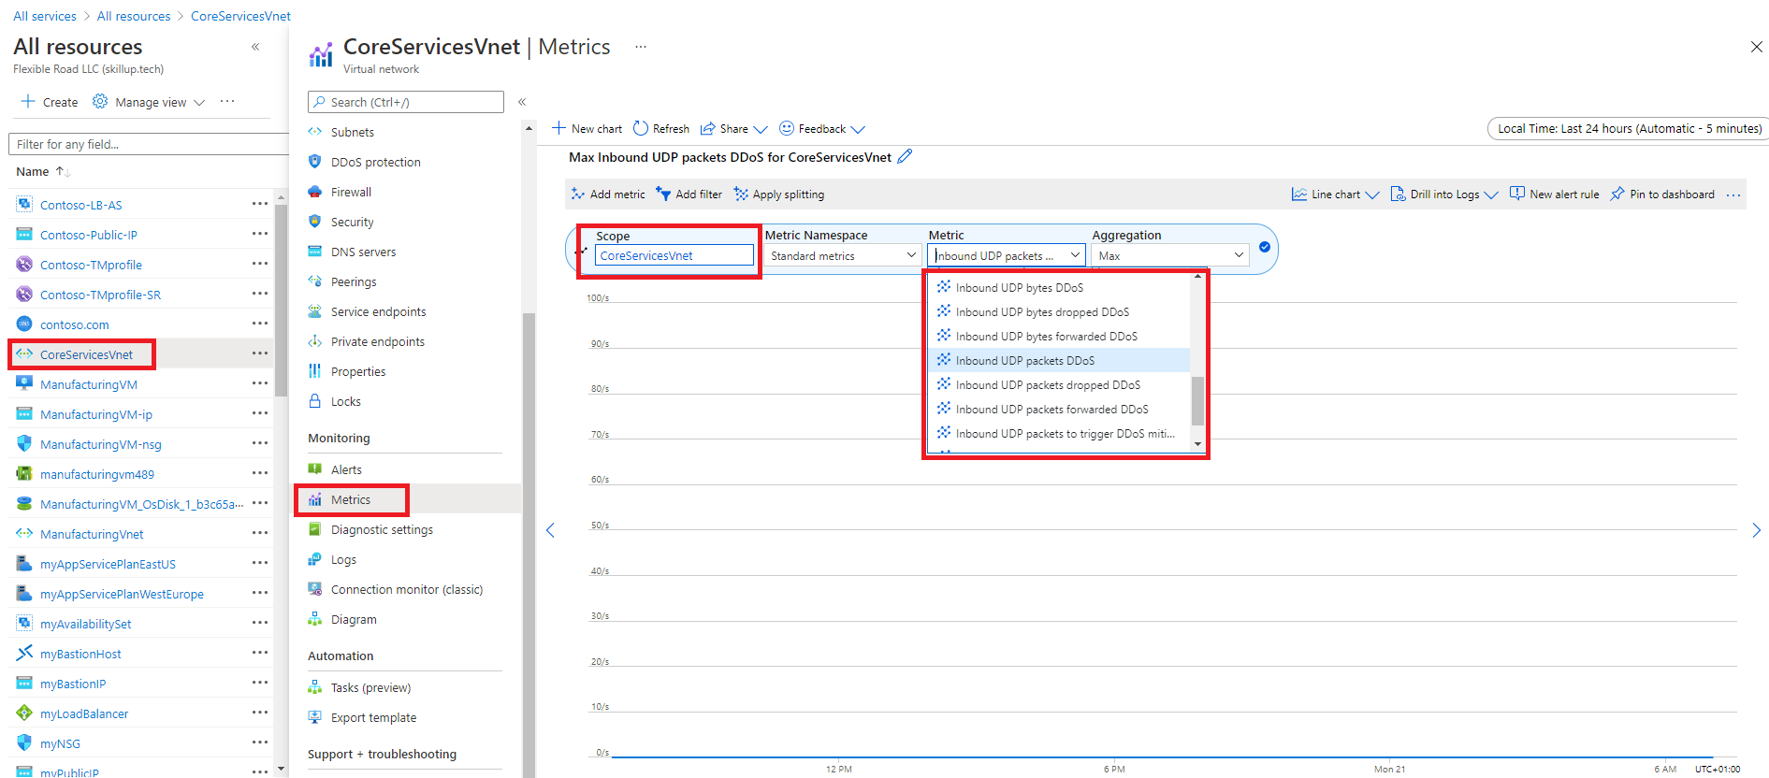
Metrics explorer
Notes:
You can access metrics from the Metrics option in the Azure Monitor menu.
You can also access metrics from the Metrics menu of most other services and resources in the Azure portal. The screenshot below for example, displays the Metrics page for a virtual network resource.
The data collected by Azure Monitor Metrics is stored in a time-series database which is optimized for analyzing time-stamped data. Each set of metric values is a time series with the following properties:
The time the value was collected
The resource the value is associated with
A namespace that acts like a category for the metric
A metric name
The value itself
You can click on these graphs to open the data in Metrics Explorer in the Azure portal, which allows you to interactively analyze the data in your metric database and chart the values of multiple metrics over time. You can also pin the charts to a dashboard to view them with other visualizations later. You can also retrieve metrics by using the Azure monitoring REST API.

Slide 7
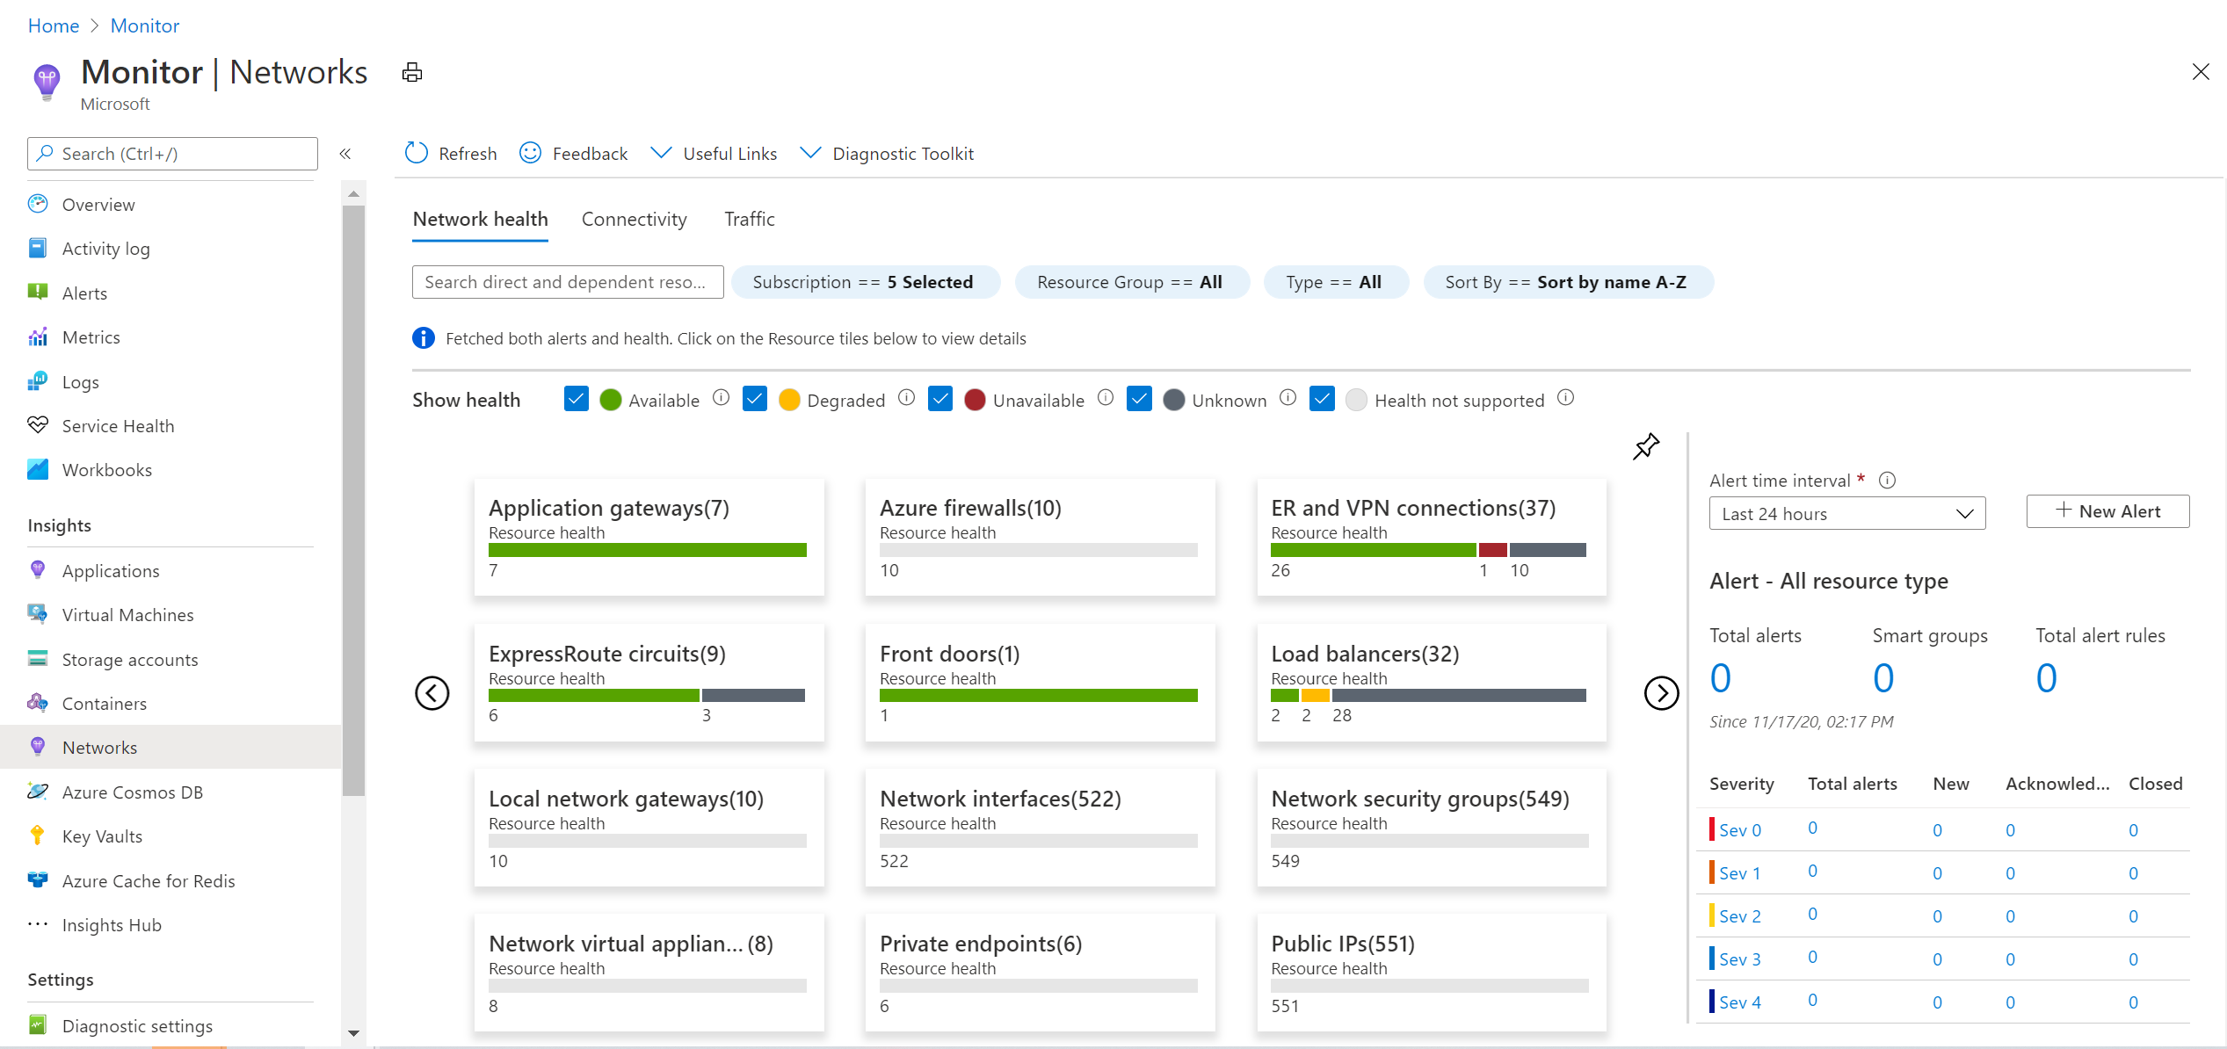
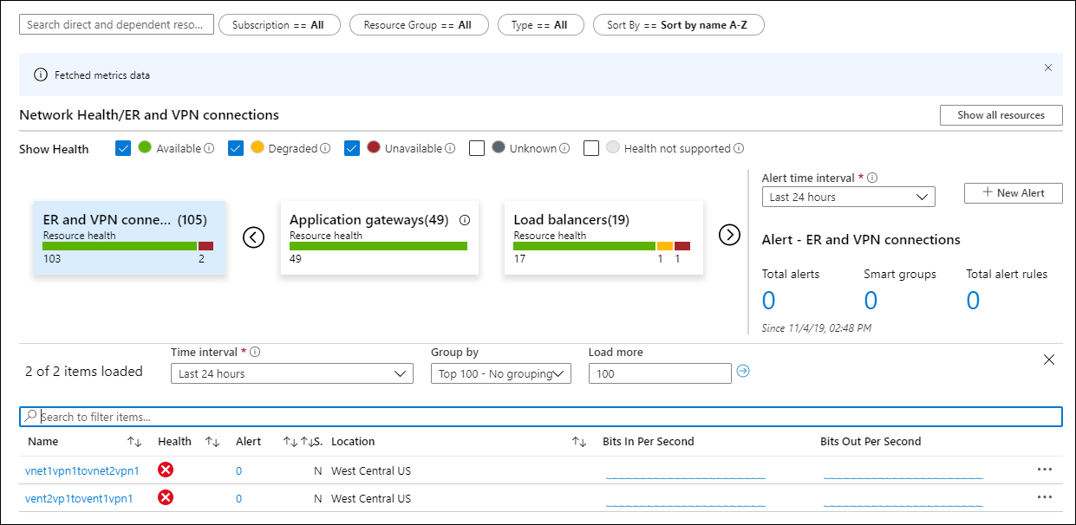
Azure Monitor Network Insights
Network health and metrics
Connectivity
Traffic
Diagnostic Toolkit
Notes:
Azure Monitor Network Insights is structured around these key components of monitoring:
Network health and metrics
Connectivity
Traffic
Diagnostic Toolkit

Slide 8
Monitor your networks using Azure Monitor - Review
Knowledge Check
Microsoft Learn Modules (docs.microsoft.com/Learn)
Azure Monitor Network Insights - Azure Monitor | Microsoft Docs
Notes:
Learn - https://docs.microsoft.com/en-us/learn/browse/

Slide 9
Lesson 02: Exercise – Monitor a load balancer resource using Azure Monitor

Slide 10
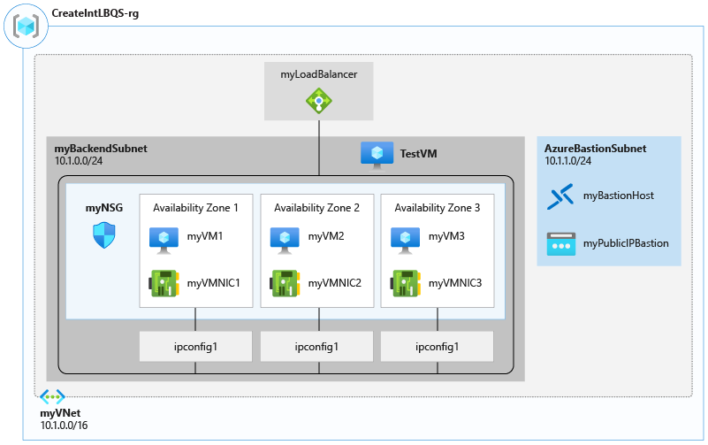
Exercise – Monitor a load balancer resource using Azure Monitor
Notes:
Create a Log Analytics Workspace
Use Functional Dependency View
View detailed metrics
View resource health
Configure diagnostic settings
Clean up resources

Slide 11
Lesson 03: Monitor your networks using Azure Network Watcher

Slide 12
Monitor your networks using Azure Network Watcher overview
Azure Network Watcher
Effective Security Rules
Topology
VPN Troubleshoot
Connection Monitor
Packet Capture
IP Flow Verify
Connection Troubleshoot
NSG Diagnostics
NSG Flow logs
Next Hop
Traffic Analytics
Review
Notes:
Configure and manage virtual networking (25-30%)
Implement and manage virtual networking
* Configure Azure DNS, including custom DNS settings and private or public DNS zones.

Slide 13
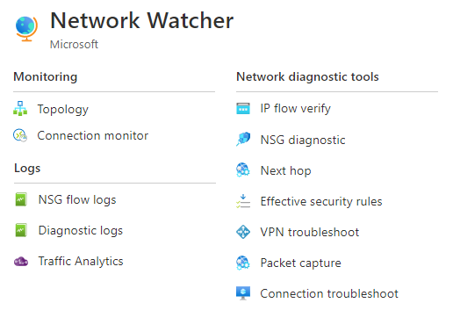
Network Watcher
A regional service that provides various network diagnostic and monitoring tools​
IP Flow Verify diagnoses connectivity issues
Next Hop determines if traffic is being correctly routed
VPN Diagnostics troubleshoots gateways and connections
NSG Flow Logs maps IP traffic through a network security group
Connection troubleshoot shows connectivity between source VM and destination
Topology generates a visual diagram of resources

Slide 14
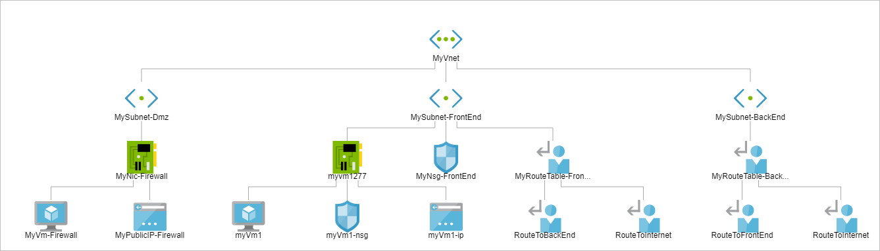
Topology
Provides a visual representation of your networking elements
View all the resources in a virtual network, resource to resource associations, and relationships between the resources
The Network Watcher instance is in the same region as the virtual network
Notes:
View the topology of an Azure virtual network - https://docs.microsoft.com/en-us/azure/network-watcher/view-network-topology

Slide 15
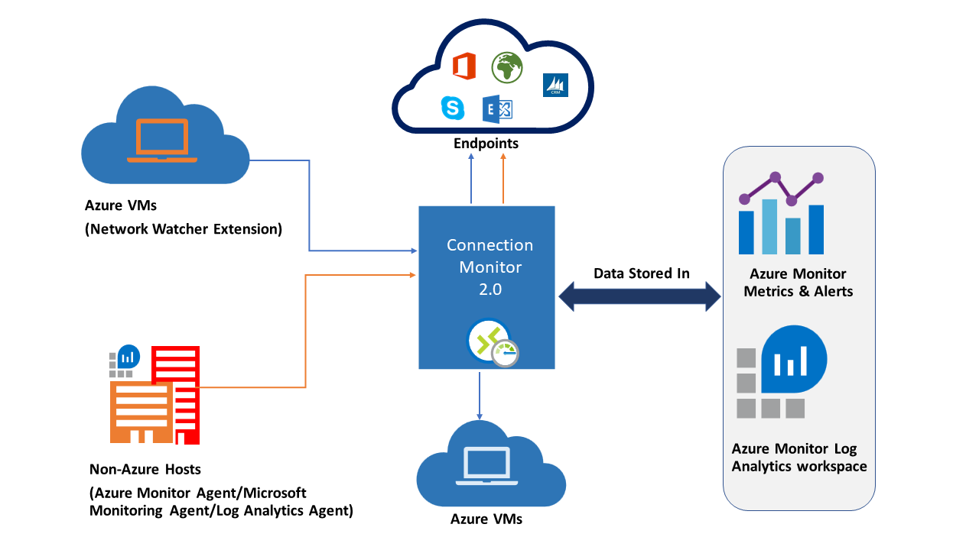
Connection Monitor
Check network connectivity between the two VMs
Compare cross-region network latencies.
Compare the latencies of the on-premises site to the latencies of the Azure application.
Check the connectivity between your on-premises setups and the Azure VMs that host your cloud application
Notes:
Connection Monitor provides unified end-to-end connection monitoring in Azure Network Watcher. The Connection Monitor feature supports hybrid and Azure cloud deployments. Network Watcher provides tools to monitor, diagnose, and view connectivity-related metrics for your Azure deployments.
Here are some use cases for Connection Monitor:
Your front-end web server VM communicates with a database server VM in a multi-tier application. You want to check network connectivity between the two VMs.
You want VMs in the East US region to ping VMs in the Central US region, and you want to compare cross-region network latencies.
You have multiple on-premises office sites in Seattle, Washington, and in Ashburn, Virginia. Your office sites connect to Microsoft 365 URLs. For your users of Microsoft 365 URLs, compare the latencies between Seattle and Ashburn.
Your hybrid application needs connectivity to an Azure Storage endpoint. Your on-premises site and your Azure application connect to the same Azure Storage endpoint. You want to compare the latencies of the on-premises site to the latencies of the Azure application.
You want to check the connectivity between your on-premises setups and the Azure VMs that host your cloud application.

Slide 16
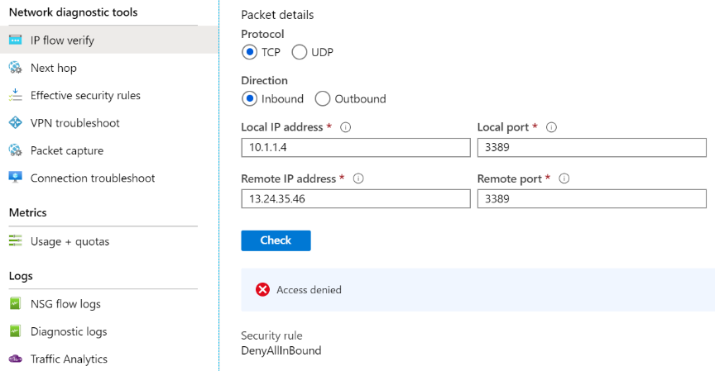
IP Flow Verify
Checks if a packet is allowed or denied to or from a virtual machine
Notes:
Introduction to IP flow verify in Azure Network Watcher - https://docs.microsoft.com/en-us/azure/network-watcher/network-watcher-ip-flow-verify-overview

Slide 17
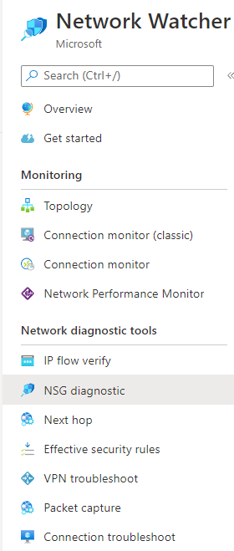
NSG Diagnostics
Used to understand which traffic flows will be allowed or denied in your Azure Virtual Network
Tool outputs whether traffic was allowed or denied
Outputs the NSG rules that were evaluated for the specified flow
Detailed information for debugging.
Notes:
For a given flow, the Network configuration diagnostics tool runs a simulation of the flow and returns whether the flow would be allowed (or denied) and detailed information about rules allowing/denying the flow. Customers must provide details of a flow like source, destination, protocol, etc. The tool returns whether traffic was allowed or denied, the NSG rules that were evaluated for the specified flow and the evaluation results for every rule.

Slide 18
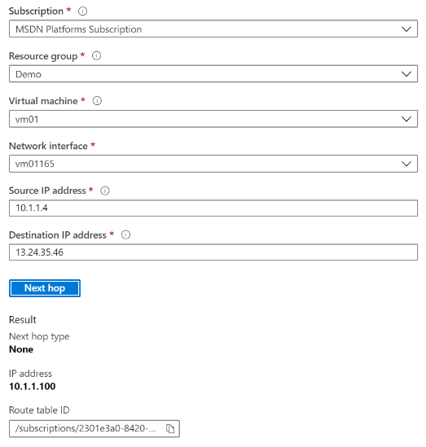
Next Hop
Helps with determining whether traffic is being directed to the intended destination by showing the next hop
Notes:
Use next hop to diagnose virtual machine routing problems - https://docs.microsoft.com/en-us/azure/network-watcher/network-watcher-next-hop-overview

Slide 19
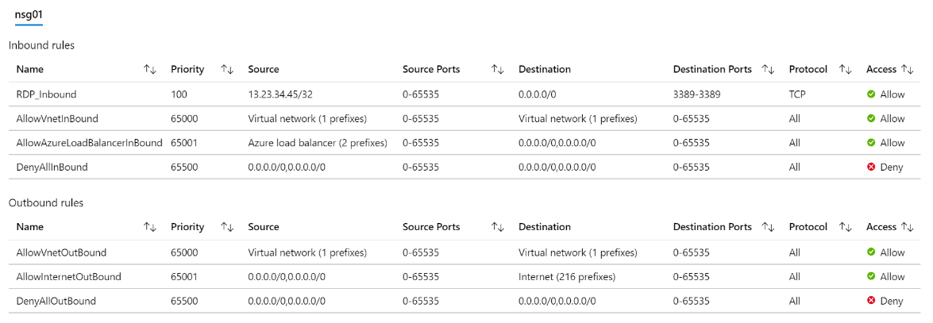
Effective Security Rules
Details the Effective Security Rules (inbound and outbound) of the Network Interface card of a Virtual Machine
Notes:
Introduction to Effective security rules view in Azure Network Watcher - https://docs.microsoft.com/en-us/azure/network-watcher/network-watcher-security-group-view-overview

Slide 20
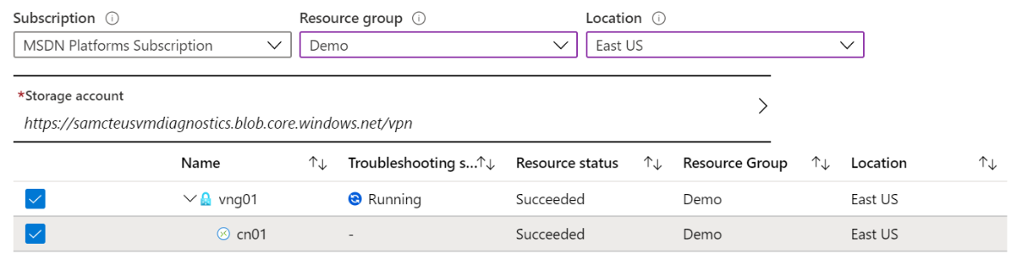
VPN Troubleshoot
Helps you troubleshoot gateways and connections
Provides summary information and detailed information
Can troubleshoot multiple gateways or connections simultaneously
Notes:
Introduction to resource troubleshooting in Azure Network Watcher - https://docs.microsoft.com/en-us/azure/network-watcher/network-watcher-troubleshoot-overview

Slide 21
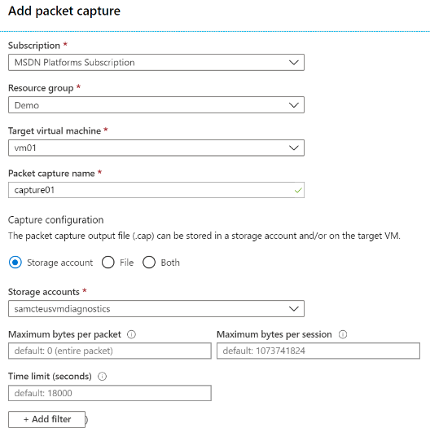
Packet Capture
Captures inbound and outbound traffic from a Virtual Machine
Saves data to a storage account, a local file, or both
Notes:
Introduction to variable packet capture in Azure Network Watcher - https://docs.microsoft.com/en-us/azure/network-watcher/network-watcher-packet-capture-overview

Slide 22
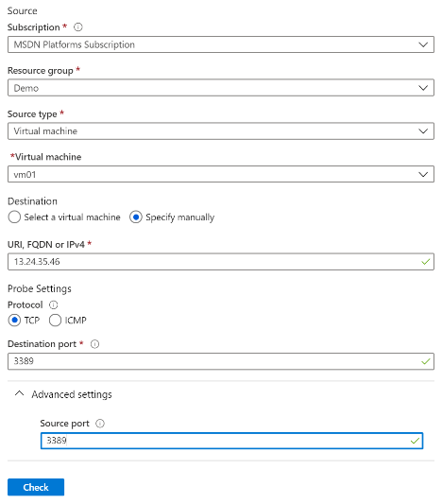
Connection Troubleshoot
Check connectivity between source VM and destination
Identify configuration issues that are impacting reachability
Provide all possible hop by hop paths from the source to destination
Review hop by hop latency – min, max, and average between source and destination
View a graphical topology from your source to destination
Notes:
Troubleshoot connections with Azure Network Watcher using the Azure portal - https://docs.microsoft.com/en-us/azure/network-watcher/network-watcher-connectivity-portal

Slide 23
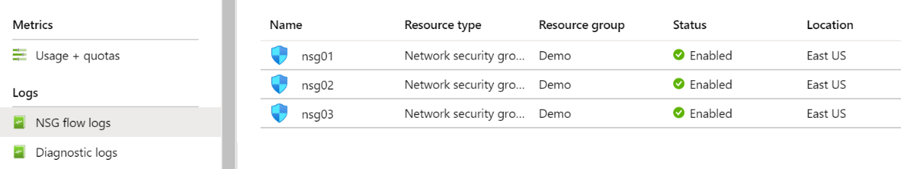
NSG Flow Logs
View information about ingress and egress IP traffic through an NSG
Flow logs are written in JSON format and show outbound and inbound flows on a per rule basis
The JSON format can be visually displayed in Power BI or third-party tools like Kibana
Notes:
Introduction to flow logging for network security groups - https://docs.microsoft.com/en-us/azure/network-watcher/network-watcher-nsg-flow-logging-overview

Slide 24
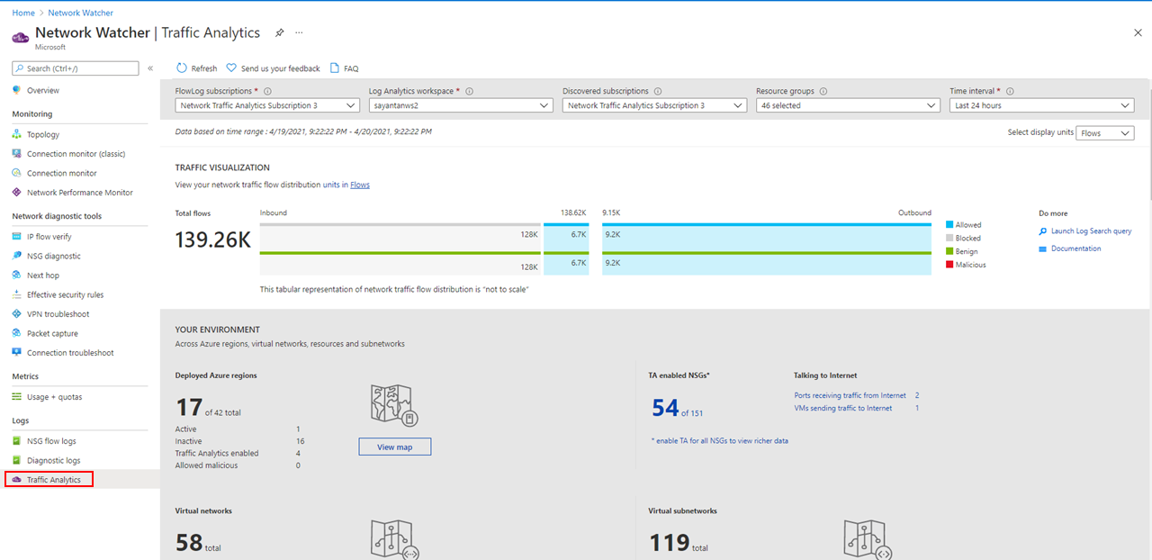
Traffic Analytics
Network security group (NSG)
Network security group (NSG) flow logs
Log Analytics
Log Analytics workspace
Network Watcher
Notes:
Traffic analytics examines the raw NSG flow logs and captures reduced logs by aggregating common flows among the same source IP address, destination IP address, destination port, and protocol. For example, Host 1 (IP address: 10.10.10.10) communicating to Host 2 (IP address: 10.10.20.10), 100 times over a period of 1 hour using port (for example, 80) and protocol (for example, http). The reduced log has one entry, that Host 1 & Host 2 communicated 100 times over a period of 1 hour using port 80 and protocol HTTP, instead of having 100 entries. Reduced logs are enhanced with geography, security, and topology information, and then stored in a Log Analytics workspace.
The key components of Traffic Analytics are:
Network security group (NSG) - Contains a list of security rules that allow or deny network traffic to resources connected to an Azure Virtual Network. NSGs can be associated to subnets, individual VMs (classic), or individual network interfaces (NIC) attached to VMs (Resource Manager). For more information, see Network security group overview.
Network security group (NSG) flow logs - Allow you to view information about ingress and egress IP traffic through a network security group. NSG flow logs are written in json format and show outbound and inbound flows on a per rule basis, the NIC the flow applies to, five-tuple information about the flow (source/destination IP address, source/destination port, and protocol), and if the traffic was allowed or denied. For more information about NSG flow logs, see NSG flow logs.
Log Analytics - An Azure service that collects monitoring data and stores the data in a central repository. This data can include events, performance data, or custom data provided through the Azure API. Once collected, the data is available for alerting, analysis, and export. Monitoring applications such as network performance monitor and traffic analytics are built using Azure Monitor logs as a foundation. For more information, see Azure Monitor logs.
Log Analytics workspace - An instance of Azure Monitor logs, where the data pertaining to an Azure account, is stored. For more information about Log Analytics workspaces, see Create a Log Analytics workspace.
Network Watcher - A regional service that enables you to monitor and diagnose conditions at a network scenario level in Azure. You can turn NSG flow logs on and off with Network Watcher. For more information, see Network Watcher.

Slide 25
Summary – Monitor your networks using Azure Network Watcher
Check your knowledge
Microsoft Learn Modules (docs.microsoft.com/Learn)
Azure Network Watcher Documentation | Microsoft Docs
Azure Network Watcher | Microsoft Docs

